Slide 1

Presented By:
G. Dimpul Chandrika
B. Nityala Sri Likitha
A. Akhila
Project on SQL
Employee Management System

Slide 2


Slide 3
Introduction
. The Employee Management System is a database-based project designed to store, manage, and organize employee information efficiently.
. It helps organizations maintain accurate employee records, monitor attendance, manage departments and job roles, and process salaries.
. This system reduces manual work, avoids data duplication, and provides quick access to information through SQL queries.
. By centralizing employee data, it improves HR operations, enhances decision-making, and increases overall organizational productivity.

Slide 4
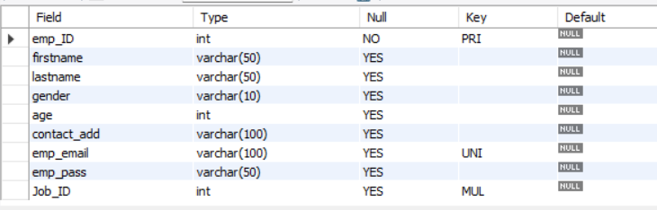
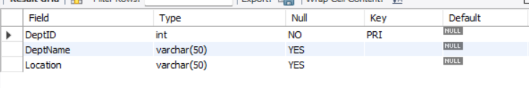
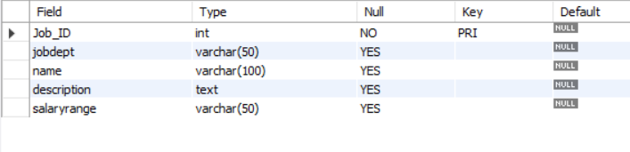
Tables
Employee Table
Department Table
Job department Table

Slide 5
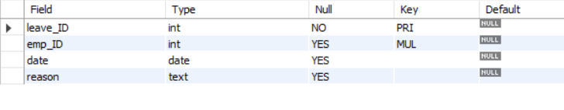
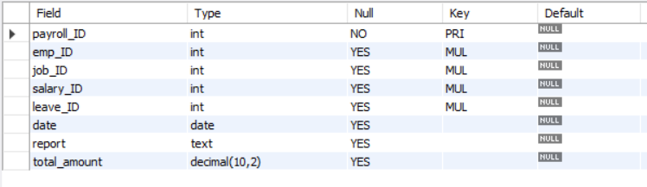
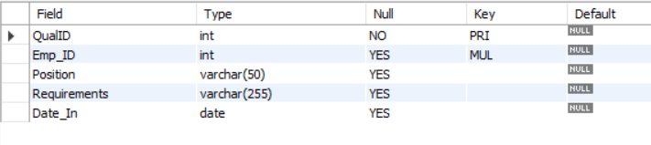
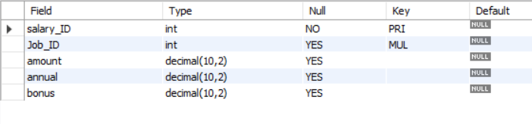
Tables
Leave Table
Payroll Table
Qualification Table
Salarybonus Table

Slide 6
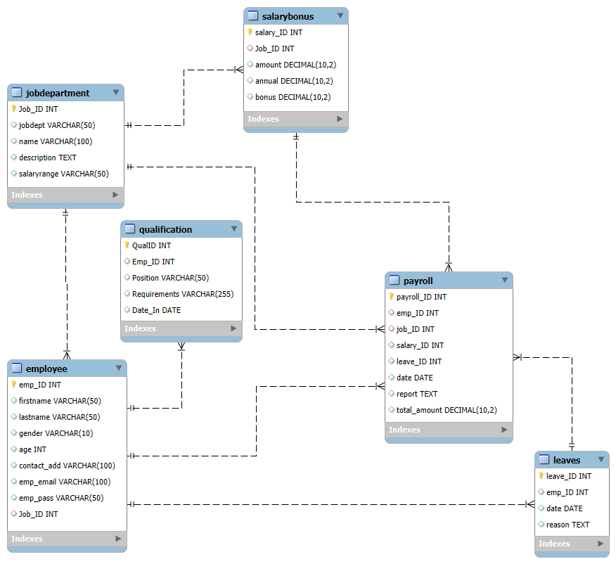
ER Diagram

Slide 7
Problem statement
Manual handling of employee data is time-consuming and prone to errors.
Difficulty in tracking attendance and maintaining salary details.
Lack of centralized data leads to duplication and inconsistency.
Reports and performance analysis take extra effort and time.
Need for an automated SQL-based system to manage employee records efficiently.

Slide 8
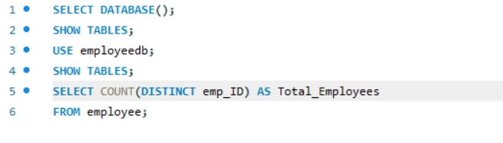

1. How many unique employees are currently in the system?
Output:

Slide 9
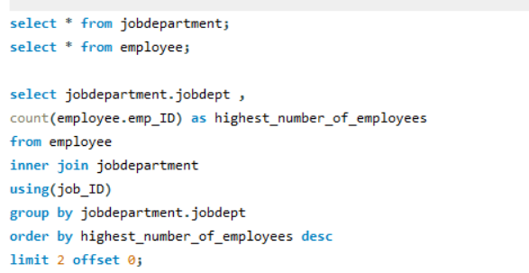
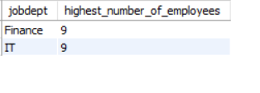
2.Which departments have the highest number of employees?
Output:

Slide 10
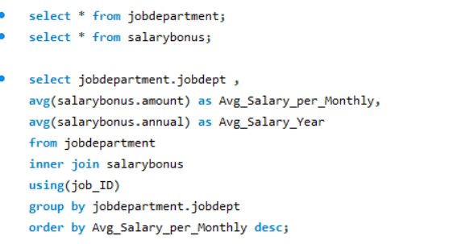
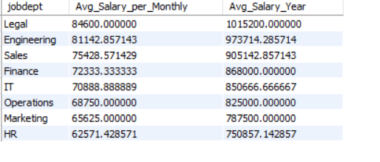
3.What is the average salary per department?
Output:

Slide 11
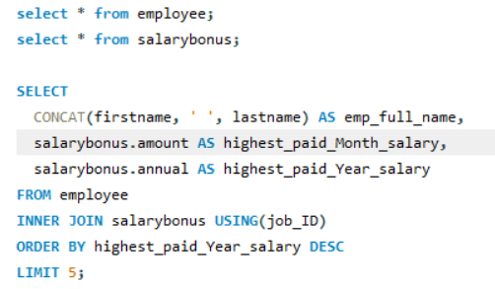
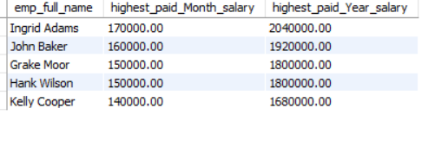
4.Who are the top 5 highest-paid employees?
Output:

Slide 12
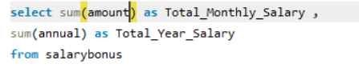

5.What is the total salary expenditure across the company?

Slide 13
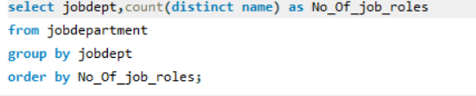
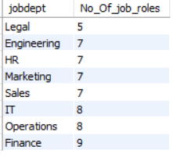
6.How many different job roles exist in each department?

Slide 14
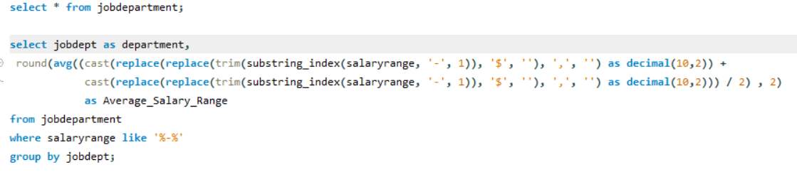
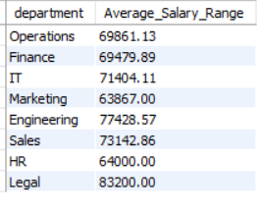
7.What is the average salary range per department?

Slide 15
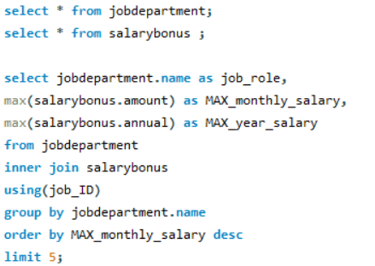
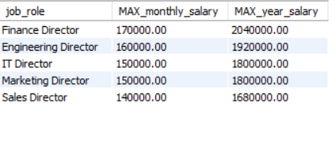
8.Which job roles offer the highest salary?

Slide 16
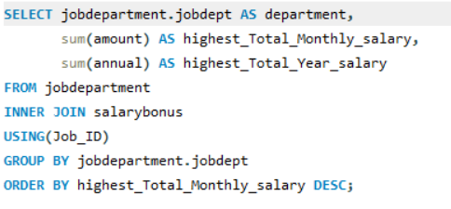
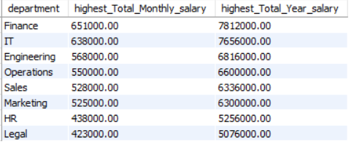
9.Which departments have the highest total salary allocation?

Slide 17
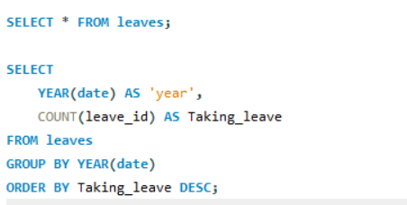

10.Which year had the most employees taking leaves?

Slide 18
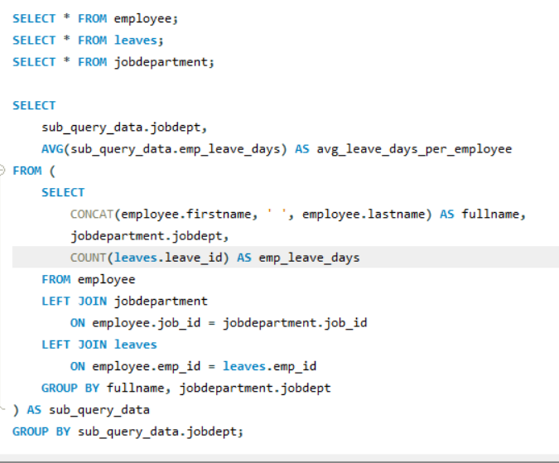
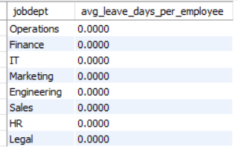
11.What is the average number of leave days taken by its employees per department?

Slide 19
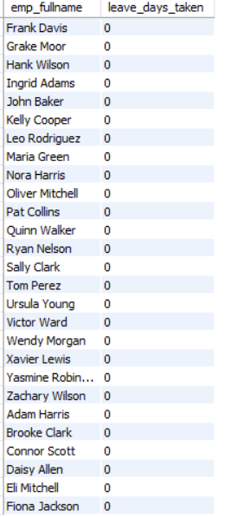
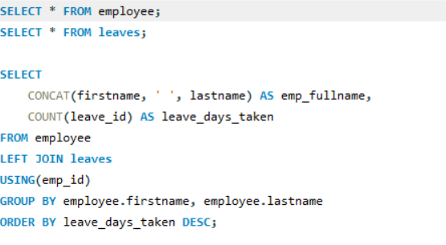
12.Which employees have taken the most leaves?

Slide 20

13.What is the total number of leave days taken company-wide?

Slide 21
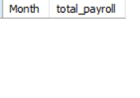
14.What is the total monthly payroll processed?
Output:

Slide 22
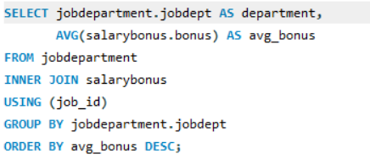
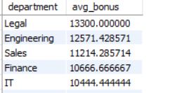
15.What is the average bonus given per department?
Output:

Slide 23
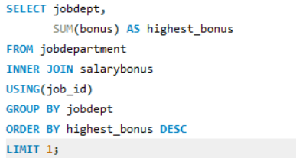

16.Which department receives the highest total bonuses?
Output:

Slide 24
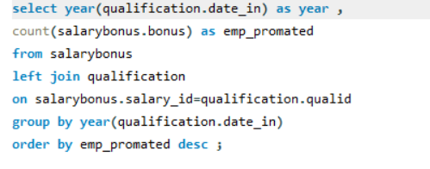

17.What is the average value of total_amount after considering leave deductions?
Output:

Slide 25
Key Insights
- Some departments have more employees than others - they are likely more important or busier.
- A few employees earn much higher salaries - they likely have special skills or higher positions.
- Payroll is managed well - it adjusts based on employee leaves.
- Certain years had more leaves taken - this could mean employees were stressed or overworked.
- Promotions are happening - based on qualifications and job changes over time.
Recommendations
- Balance the team - move people from crowded departments to ones that need more help.
- Pay smartly - make sure high salaries and bonuses go to top performers.
- Watch leave patterns - if too many people take leave, check if they are facing issues.
- Use tools - create simple reports and dashboards to track salaries, leaves, and bonuses.
- Support growth - help employees grow with training and clear paths for promotions.

Slide 26
Conclusion
The Employee Management System effectively tracks employees, salaries, leaves, and job roles in one place, making HR processes more organized and transparent.
- It shows that some departments have more staff and higher salaries, indicating where most of the work is concentrated.
- Payroll is handled efficiently, with accurate salary deductions for leaves.
- Patterns in promotions and leaves provide insights into employee growth and workload pressure.
- Overall, the system supports smarter decision-making in workforce and salary management, and with a few improvements, it can further enhance efficiency and planning.

Slide 27
Challenges:
. Defining correct table relationships and ensuring accurate use of foreign keys.
. Maintaining data consistency with cascading updates and deletes.
. Writing complex joins for reports involving employee roles, leaves, and payroll.
. Ensuring all date fields follow the YYYY-MM-DD format for reliable time-based analysis.
. Preventing duplicate entries using unique constraints, especially on email fields.

Slide 28

THANK YOU

